Slide 1

Ruben Arutyunov, Sarvani Dasari, Jamie Friedt and Price Ketterling

Slide 2

About Capturis
A NISC Company that provides multi-site businesses with a utility information management service.
The services offers:
Utility bill payment administration
Utility information services
Utility consumption
Cost Tracking
Capturis processes and pays your utility bills prioritized by due date.
Capturis gathers information needed to make sound business decisions in a user-friendly database-reporting tool available online.

Slide 3
Introduction
Capturis
Wendi Bates – Customer Account Representative(Sponsor)
David Aichele- Software Director(Co-Sponsor)
Royce Havelka – Senior Software Developer (Technical Mentor)

Slide 4

Problem
Capturis relies upon third party vendors to test data entry applicants
Relying on these vendors to evaluate each candidate is costly, especially when considering the number of candidates that are tested in relation to the number selected for employment.
Additionally, these vendors often times expire the test results, requiring additional tests if the candidate applies in the future.

Slide 5

Solution
Create a web based tool that utilizes the 10 Key Pad.
10 Key Speed is measured in Keystrokes Per Hour (KPH). KPH defines how many keys one can hit per hour.
Accuracy is just as important as speed, so the assessment tool will also monitor how many errors an individual makes.

Slide 6

Solution
Registration page
Login Page
User dashboard
Assessment page
Results page
Manager page
Administration page

Slide 7

Schedule
Week 2-5 : Preparation of the project
Environments (Angular)
Tutorials
UI designs
Database
Week 6-7:
Connections with the database
Server connections
Week 8: Designing the pages
Creating the pages and routing them
Notes:
An efficient way to solve the problem

Slide 8
User-Points
1 | Register on site | 3
2 | View previous assessment results | 3
3 | Take 10 key assessment (Four Types) | 8
4 | Reset password | 6
5 | View statistics about all assessments | 5
6 | View results of other users (Manager) | 5
7 | Delete users (Admin) | 2
8 | Define user roles | 2
9 | See employees under user | 2
10 | Set up database | 3
11 | Set up development environments | 3
12 | Sketch UI design | 4
13 | Hook up project (FE, BE, DB, GitHub) | 6

Slide 9

Progress
Created a front-end and a back-end environment
UI designs
Designed Login, Registration, User-dashboard and Assessment
Random number generator
NodeJS
Database

Slide 10
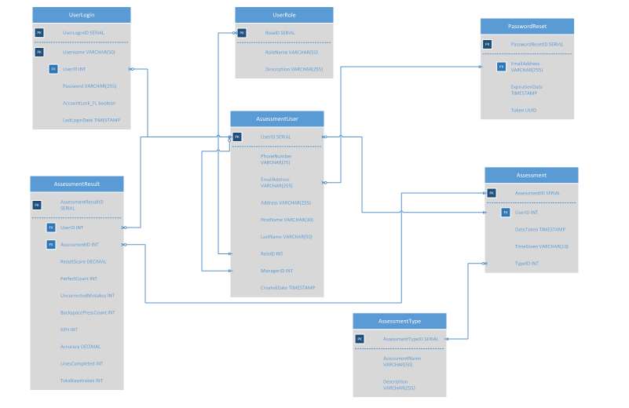

Slide 11




Tools
Postgres database
NodeJS
Angular 2+
GitHub
Google Hangout
Google Drive

Slide 12
Demo

Slide 13

Risks Issues
Cheating
Goals per sprint
Framework
Resources for environments
Server
Designing pages
NodeJS vs Java
Standard for coding
Environment – Completed
Framework—there is a steep learning curve
Design issues
Redefining roles
Server connection and backend
NodeJS vs Java

Slide 14
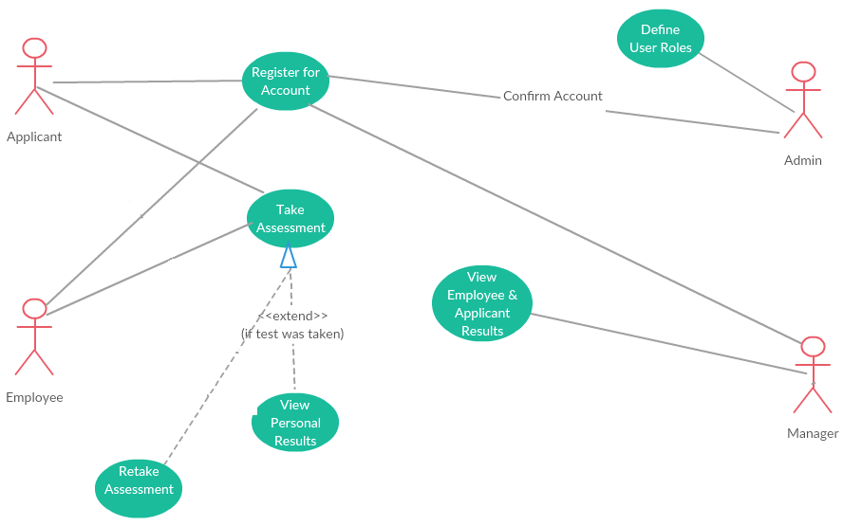
User-Story

Slide 15
Reflection
Learning experience
Angular
Setup
Database design – Postgres
Setbacks
Java
IntelliJ
Jersey/Jetty
Team Bonding
Github

Slide 16

Next Steps
Add functionality to the pages
Refine the pages
Add Administrator page
Add Manager page
Authentication/Validation
Creating the other tests
Documentation / SRS
Connections
Having a great time

Slide 17
Questions?

